Slide 1
Whitelands College Est: 1841
orientation

Slide 2
Todays Timetable
 | Date | Event | Start | End | Length
Mon | Sept-21st | College Introduction (All new students) | 12pm | 2pm | 2 Hours
 |  | Welcome (HoC/CLDO) | 12pm | 12.10pm | 10 mins
 |  | What’s new in the college for this year? (CLDO) - explain housing arrangements, communal space restrictions, new merch purchasing, etc. ) | 12.15 pm | 12.30 pm | 15 mins
 |  | Expectations for this year (CLDO) | 12.35pm | 12.40pm | 5 mins
 |  | Meet/Interact with your core college team (SWO, Chaplain, Warden, etc) | 12.45pm | 1.15pm | 30 mins
 |  | Health and Safety in the College (CLDO) | 1.20pm | 1.30pm | 30 mins
 |  | Website and Handbook | 1.30pm | 1.35pm | 5 mins
 |  | Community | 1.40pm | 1.50pm | 10 mins
 |  | Questions | 1.50pm | 2.00pm | 10 mins

Slide 3
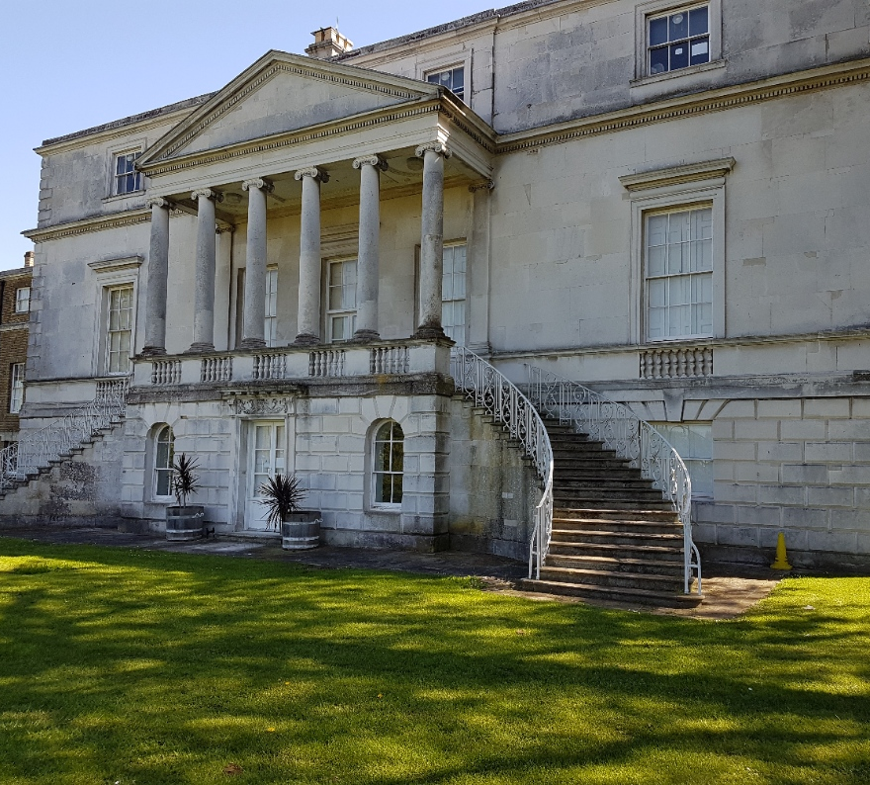
A unique area with beautiful views
Parkstead house was built in the 1760’s

Slide 4
Our Facilities
What does Whitelands College have to offer you?

Slide 5
On Site 24hr computer suite

Slide 6
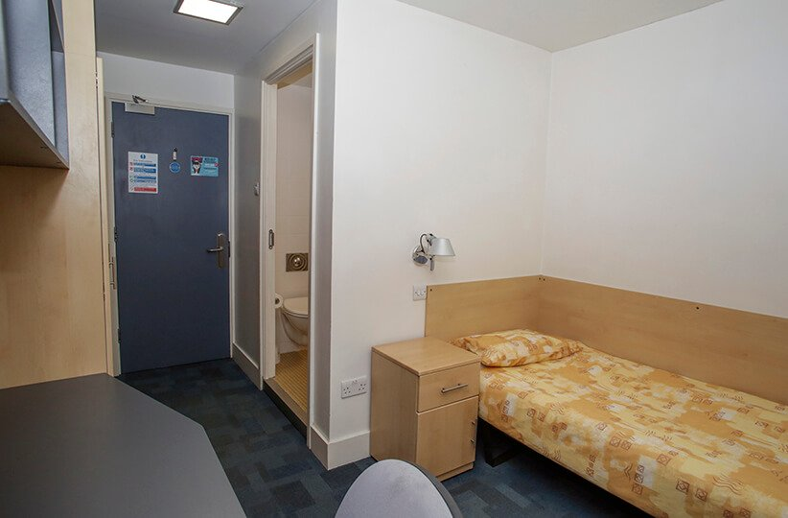
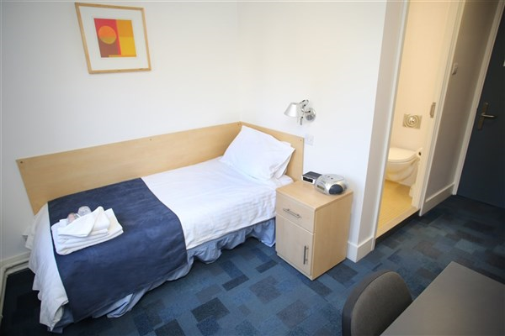
Comfortable on-site accommodation

Slide 7
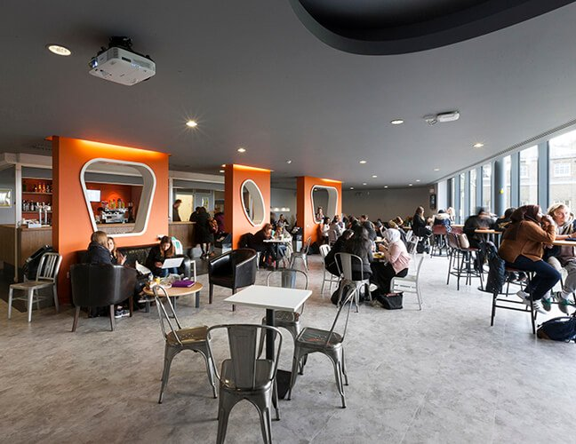
On-site student bar (SETT)

Slide 8
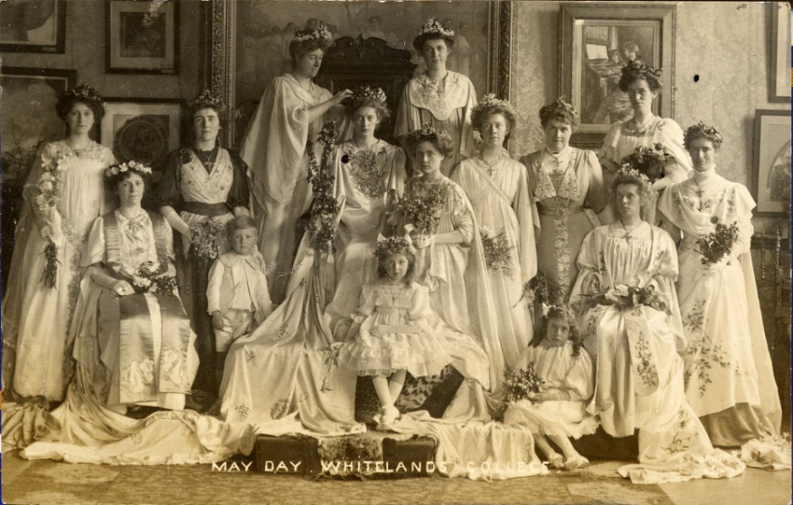
Annual May Day Celebration Est: 1881

Slide 9
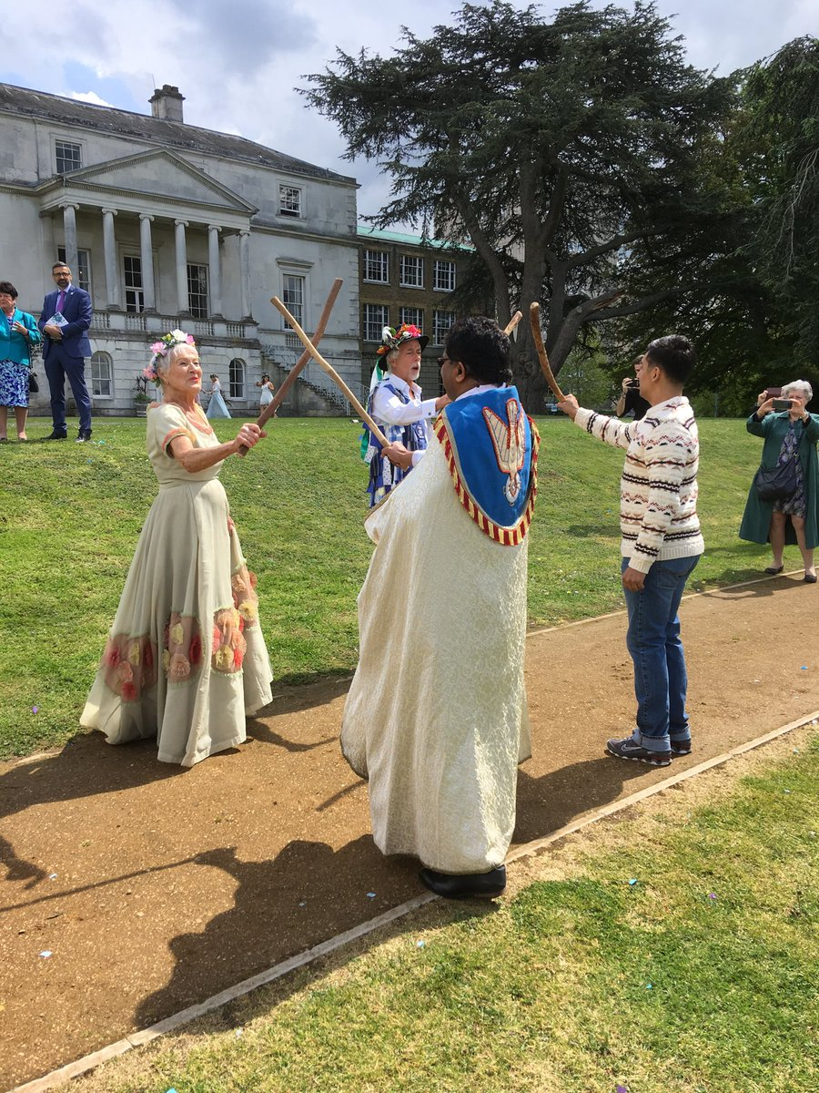
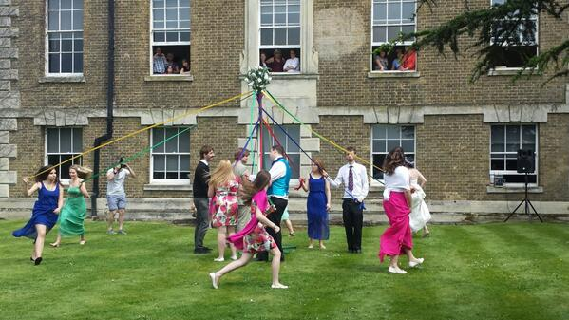
May-Day: 2019

Slide 10
Merchandise
We are in the process of having a new online ordering service set up which will be a joint operation between all four Colleges
You will be able to purchase hoodies/jumpers from this company and have them delivered to you on University (postal room).
We will also expand into more products as the term goes on including:
Lanyards
Pins
Pens
Cups
Ext…

Slide 11
Code of Conduct
Not behave in any way which may be considered threatening or disruptive, or being likely to lead to injury or physical or emotional harm to any of its students or staff;
Not intentionally damage or deface any University, College or Student Union building or other property;
Act within the law and not engage in any activity or behaviour likely to bring the University into disrepute.

Slide 12
A students college support team
Flat reps
College Warden
Senior College Warden
Student Well being Officer (SWO)
College Life Development Officer (CLDO)
Head of College (HoC)
College Chaplain
Student Elected Officers

Slide 13
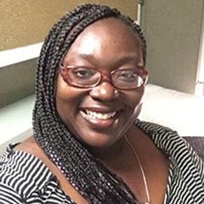
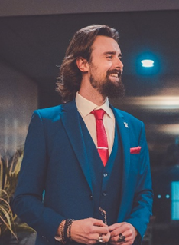
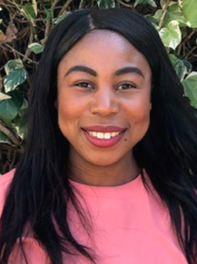
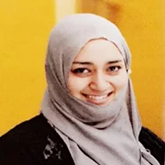
Your Whitelands College Team
Senior College Warden
Shai Danmole-Ellis
Head of College
Dr R David Muir
CLDO
Steven Taggart
SWO
Gloria Williamson
Chaplain
Dr Daniel Eshun
Muslim Chaplain Sabiha Iqbal

Slide 14
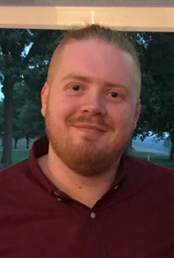
Your Student Elected Officers
May Monarch George Thorn
College President
Libby (Elizabeth) Spooner

Slide 15
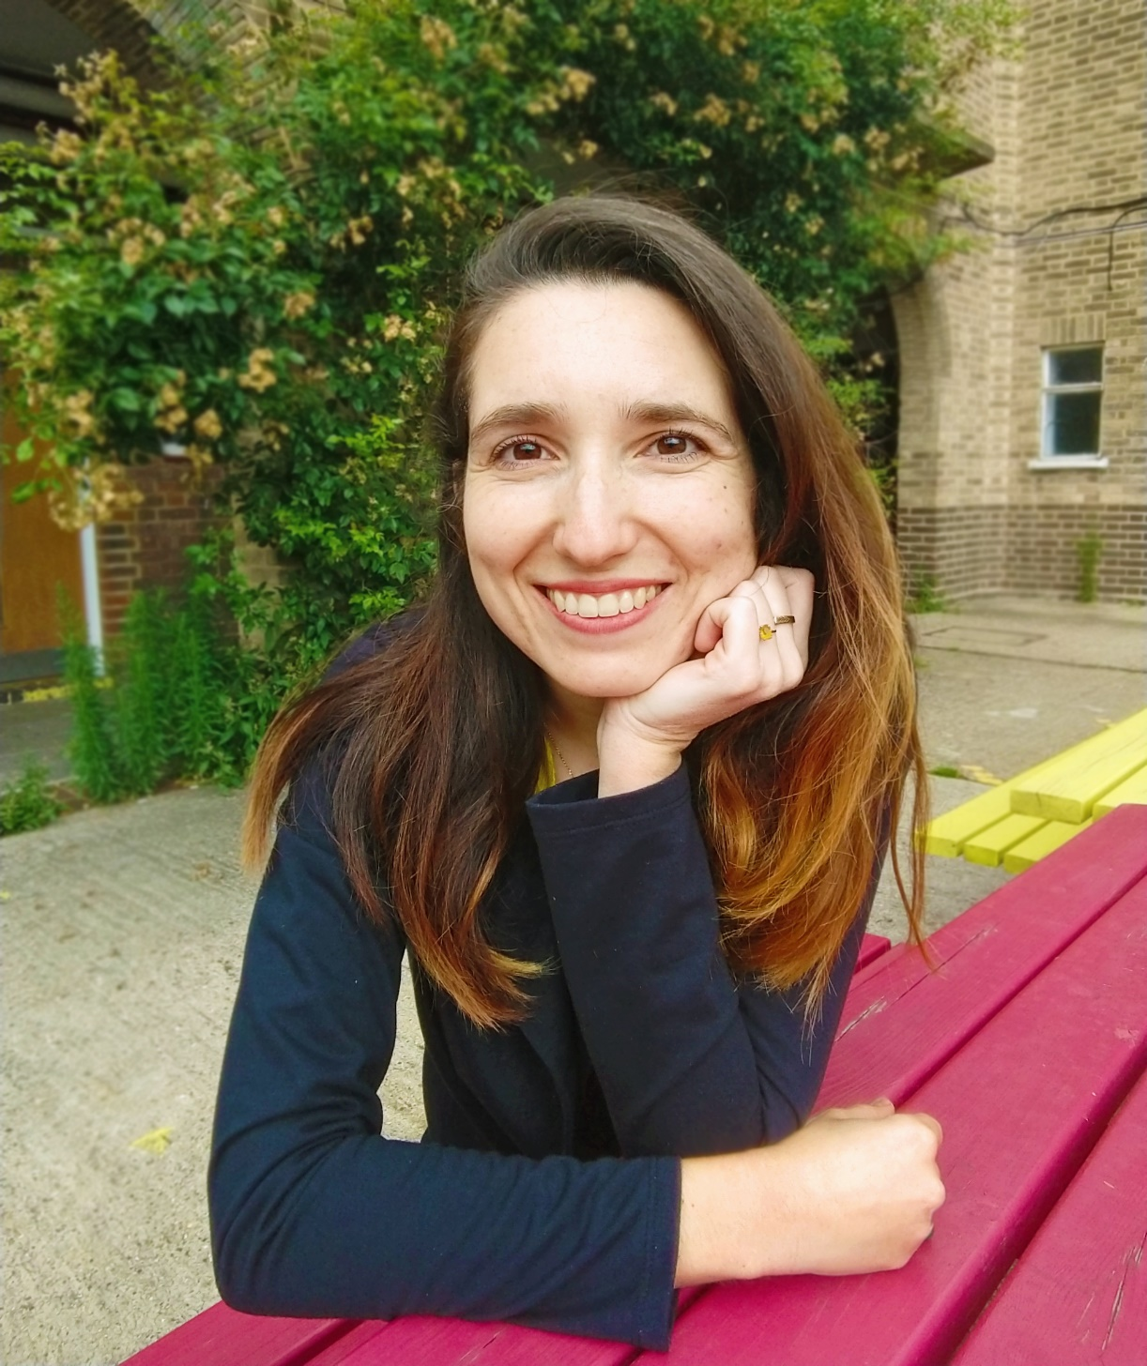
24-hour security and on-site Warden
Whitelands College Warden
Isis De Carvalho Stelmo

Slide 16
Roehampton Students Union (RSU)
https://www.roehamptonstudent.com/

Slide 17
Our College Website

Slide 18
College Handbook
https://www.roehampton.ac.uk/colleges/whitelands-college/

Slide 19
New one way System

Slide 20
Parkstead one way system

Slide 21
New Car Park Spaces
Student car parking in light of COVID-19
Social distancing and planning for the return to campus mean that the University has considered how to manage parking effectively once teaching begins again in September. The information below reflects plans for parking until Christmas.
Car parking for students will be available in Queen Mary’s Hospital car park, from 1st October 2020
Daily, weekly or termly tickets will be available, and tickets are to be booked in advance and paid online via the Estore if you wish to purchase the Weekly or Termly pass. If you wish to purchase the daily pass then you can do this via Security at Stuart Lodge in Digby Stuart. All passes will be allocated on a first-come, first served basis. There will be 100 spaces available.
Costs will be as below:
If you have any further questions at this stage, please contact Parking@roehampton.ac.uk
Ticket type | Cost
Daily | £5
Weekly | £15
Termly (equivalent to 3 daily charges per week so a significant saving) | £180

Slide 22
Coronavirus (COVID-19)
Student Information

Slide 24
If you feel unwell
You must not travel to campus or leave your bedroom in halls of residence if you have or suspect you might have coronavirus (COVID-19) or are told to self-isolate by the University or the NHS. Check your symptoms, get a test and follow NHS Guidance.
The symptoms of coronavirus include:
A high temperature
A new, continuous cough
A loss or change to your sense of smell or taste
You must inform the University in any of these circumstances by emailing cvreports@roehampton.ac.uk.

Slide 25
Our expectations
of students
Face coverings
Unless you are exempt, face coverings must be worn on-campus in all shared indoor spaces and externally where a 2m distance cannot be maintained. You must also wear a face covering in class, unless you are exempt.
Physical distancing
The more people you socialise with, the higher the likelihood the virus can spread. You should only socialise with up to six people at any one time indoors or outdoors.
Hand washing
You should wash your hands regularly, including before and after leaving rooms and when eating and drinking.
Respecting others
Staff may ask you to do things in a slightly different way to what you may have been used to, so please follow their instructions and agree to the Shared Statement of Responsibility on the Student Portal.
Track and trace
Tap into all on-campus spaces where there is a card reader using your student I.D and pre-book onto events and activities.

Slide 26
Further information
Check your symptoms
111.nhs.uk/covid-19/
UK Government
gov.uk/coronavirus
Roehampton
roehampton.ac.uk/coronavirus
For all other information
cvreports@roehampton.ac.uk

Slide 27
All information can be found on Student Portal

Slide 28
Basic Covid Safety
You must follow all of the University and Government rules
The rule of 6 (both indoors and outdoors) – But… Your flat is a ‘household’ (so a flat of 8 can be together)
No parties, no mixing of different flats (households)
No external visitors to a flat
Remember, these rules are the same as the ones you follow at home – You would not be able to hold parties of different households at home either

Slide 29
Community

Slide 30
belonging
The building block of a community

Slide 31
Do you know How many communities are you part of?
Notes:
What aspect does being part of all these communities have in common for you? BELONGING

Slide 32
Belonging- what does it mean ?
What does belonging mean to you?
What has made you feel like you belong somewhere or as part of a group?
What has made you feel like you don’t belong?
Notes:
Discussion from group
Examples such as:, being included in conversations and decision making, having your opinions sought, getting your name correct, remembering small personal details that show you were being paid attention to, acceptance of individual differences, the kind of language used around you etc.

Slide 33
A little maori wisdom
Notes:
Notes: The key to belonging is connection; with oneself, the environment and with others.

Slide 34
Your circles of belonging here at Roehampton
The University
Your Academic Department
Your course of study
Your College
Your Flat
Your Sports team(s)
Your Student Society(ies)
NAME 5 MORE!
Notes:
Discussion: What other circles of belonging are there for our students?

Slide 35
Advantages of a sense of belonging?
Support “ I am not alone”
Strength and Influence
Innovation
Reduced isolation and improved wellbeing

Slide 36
Thankyou for coming! Any questions?

